Slide 1
(Peter)G.Lu Project portfolio

Slide 2
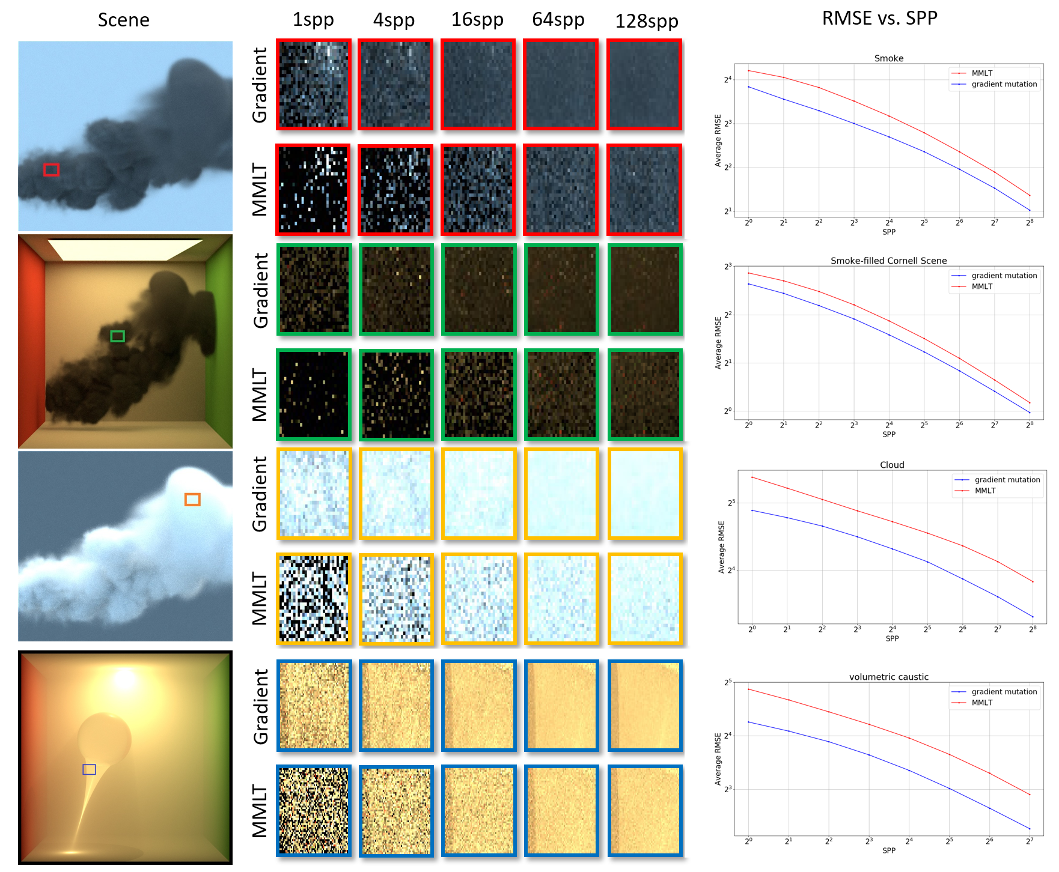



Master’s thesis project Gradient-Domain Volume Rendering
We compute the path-space gradient of one light path with respect to one vertex in the medium; then, we design a strategy to generate correlated paths in MMLT and use this gradient algorithm to estimate the contributions. We can do so with limited computation, as we avoid the expensive construction and radiance evaluation of entirely new paths.

Slide 3
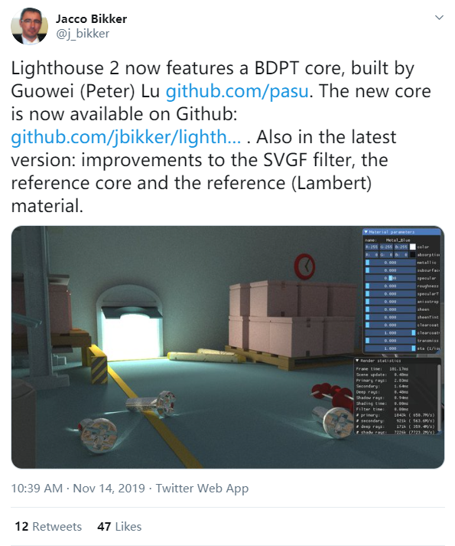
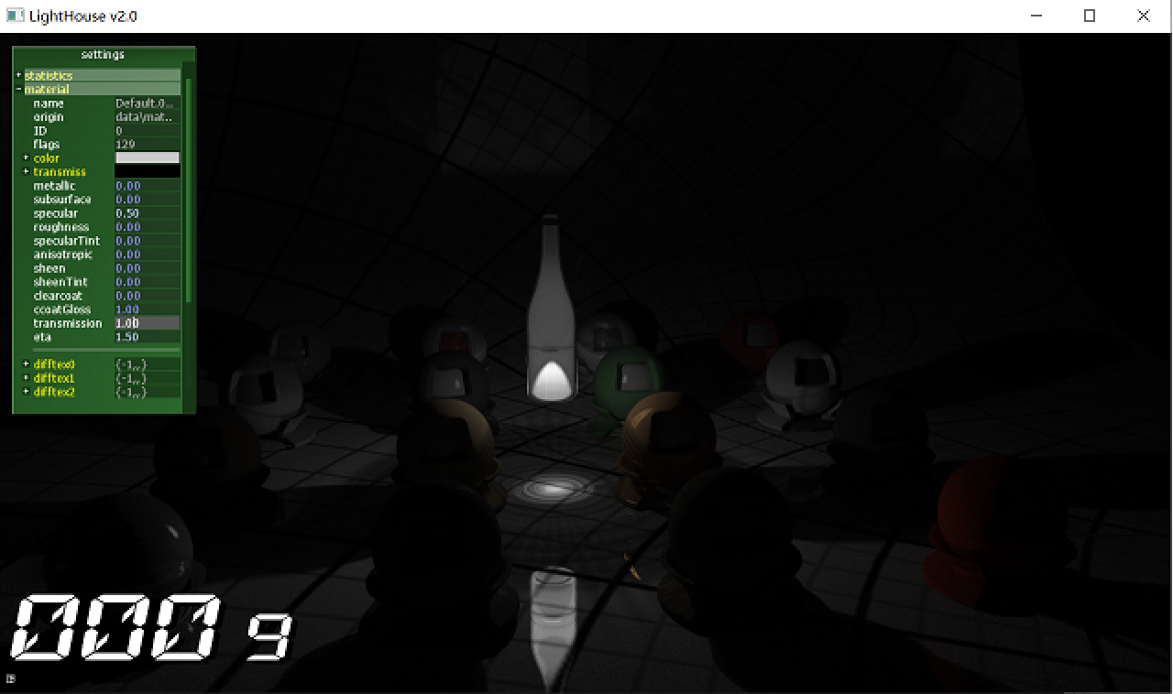
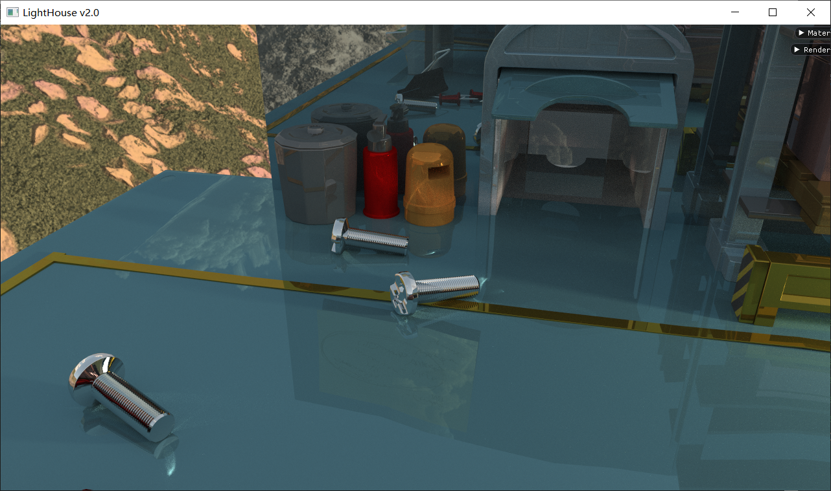

Small project Streaming BDPT based on Light House 2
Light House 2 is a rendering framework for real-time ray tracing. I built this streaming BDPT render system, which can handle difficult lighting setting such as caustic and non-symmetric scattering situations including refraction and shading normal.
Major skills include:
C++
CUDA
OptiX
Wavefront
Batching Ray for visibility test

Slide 4
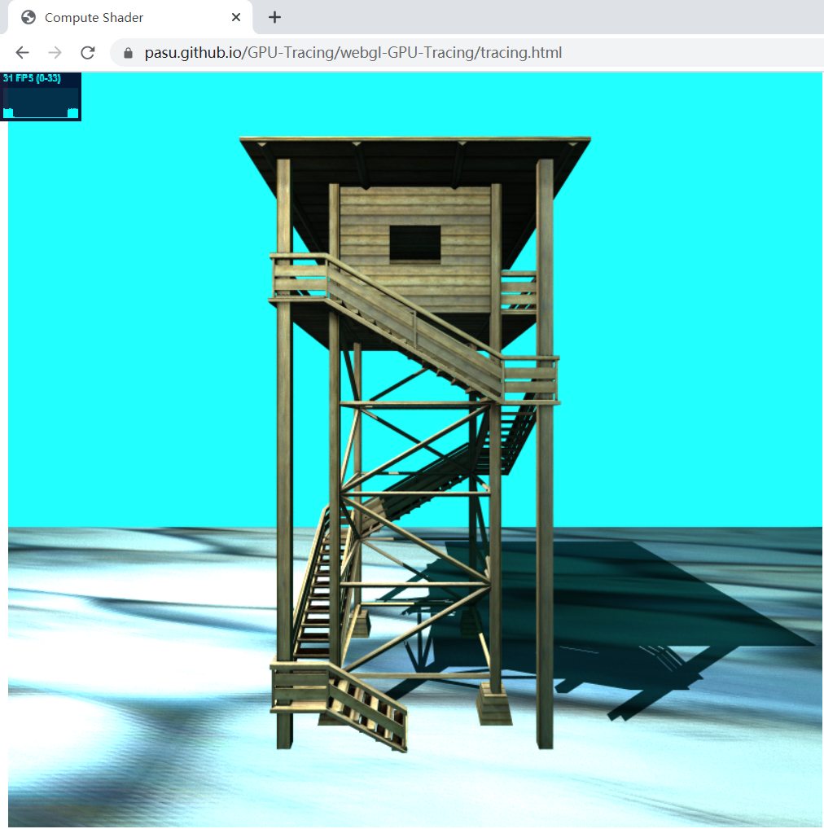

Path Tracing (GPU&WebGPU) C++/JS/Compute Shader
A path tracing toy written in C++ and JS. Uses computer shader. You can build the BVH of the scene and save it as binary on the desktop, then, load this binary and view the scene interactively on the Browser which supports WebGL 2.0 Compute. It supports wavefront and megakernel.

Slide 5
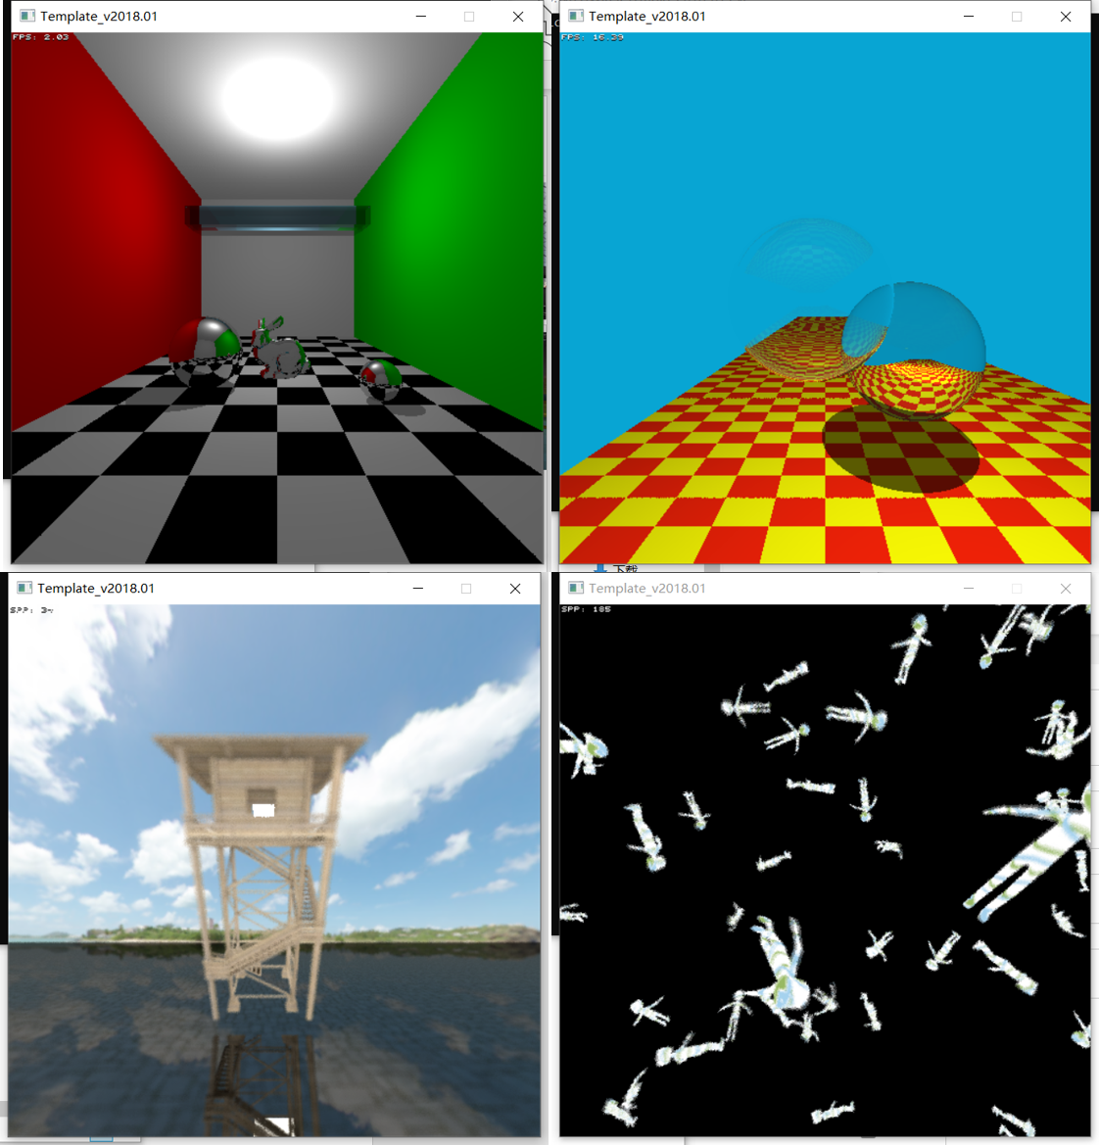
Path Tracing (CPU) C++
A fully featured ray tracing, which is the assignment of the Advanced Graphics. Major features are:
BVH (SAH + Top-Level + SIMD Intersection)
NEE+MIS, Photon Mapping (Simple), Ray Packets
Depth Field, Motion Blur
Multithreading, Filter

Slide 6
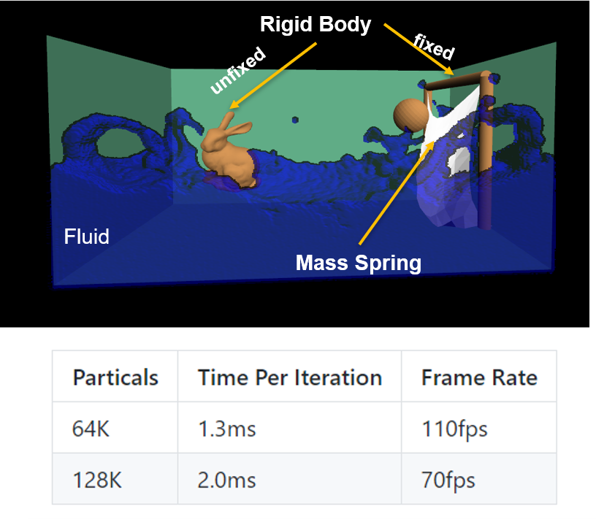
Position Based Fluid Simulation C++/Compute shader/OpenGL
Fluid simulation is the Mini-project of the course ‘Game Physics’, which was inducted into the Game Physics Hall of Fame (2nd place). The key idea is enforcing incompressibility using position constraints. It includes fluid-rigid body, fluid-cloth interaction and fluid surface reconstruction.

Slide 7
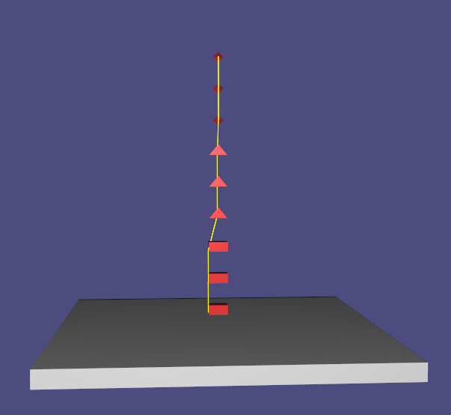
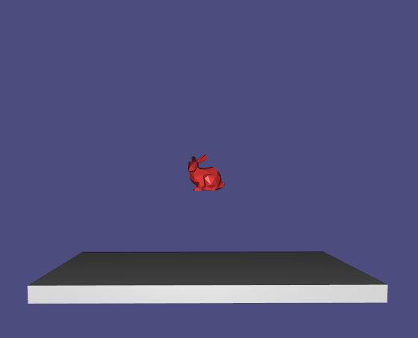
Rigid and Soft Body Simulation C++
This is the assignment of the course ‘Game Physics’. It includes three parts:
Rigid bodies and collision
multiple interpenetrations and collisions
impulse-based collision resolution
Constraints
Finite-Element Soft-Body Deformation
Rigid bodies and collision:
Constraints :
Soft-Body Deformation:

Slide 8
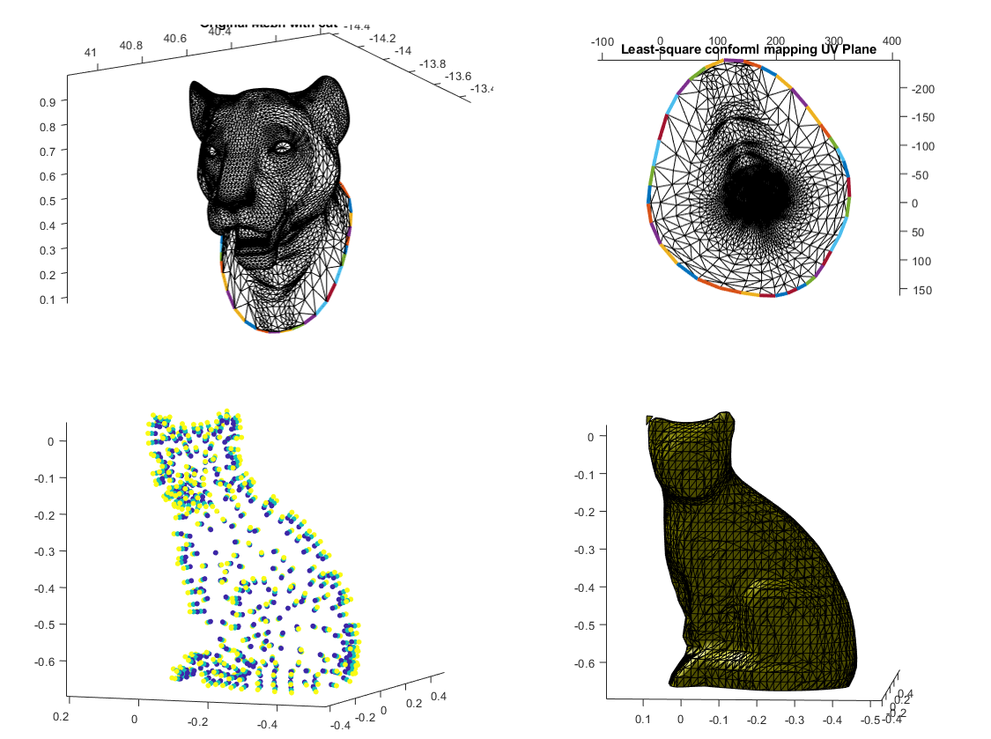
3D Model matlab
I self-studied the course '3D model' and did these practices including linear least-squares system using sparse matrices, a simple version of the moving least squares, and Least-Squares Conformal Mapping algorithm. Academic integrity: I did this practice with the help of the reference code. Strictly speaking, this is not my own code

Slide 9
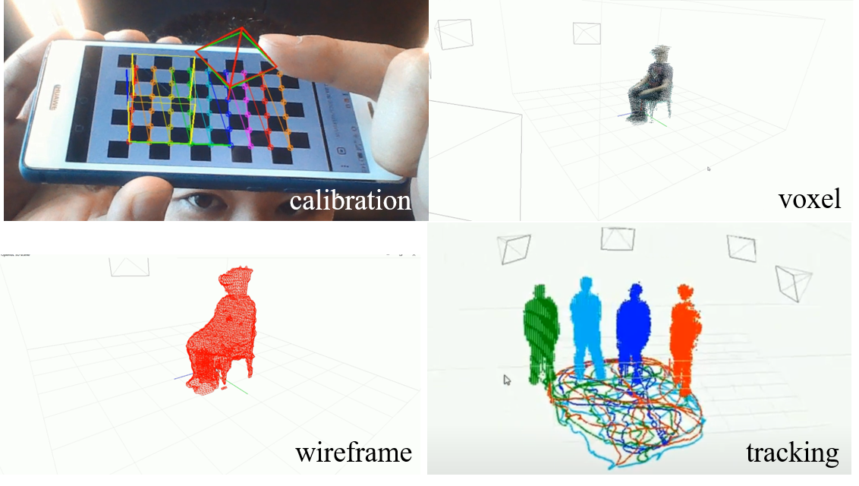
Voxel-based 3D Reconstruction and Tracking C++/OpenCV
This is the assignment of the course ‘Computer Vision’, which includes the camera calibration, voxel-based 3D reconstruction and tracking. The major skills are:
Marching cube
K-means

Slide 10
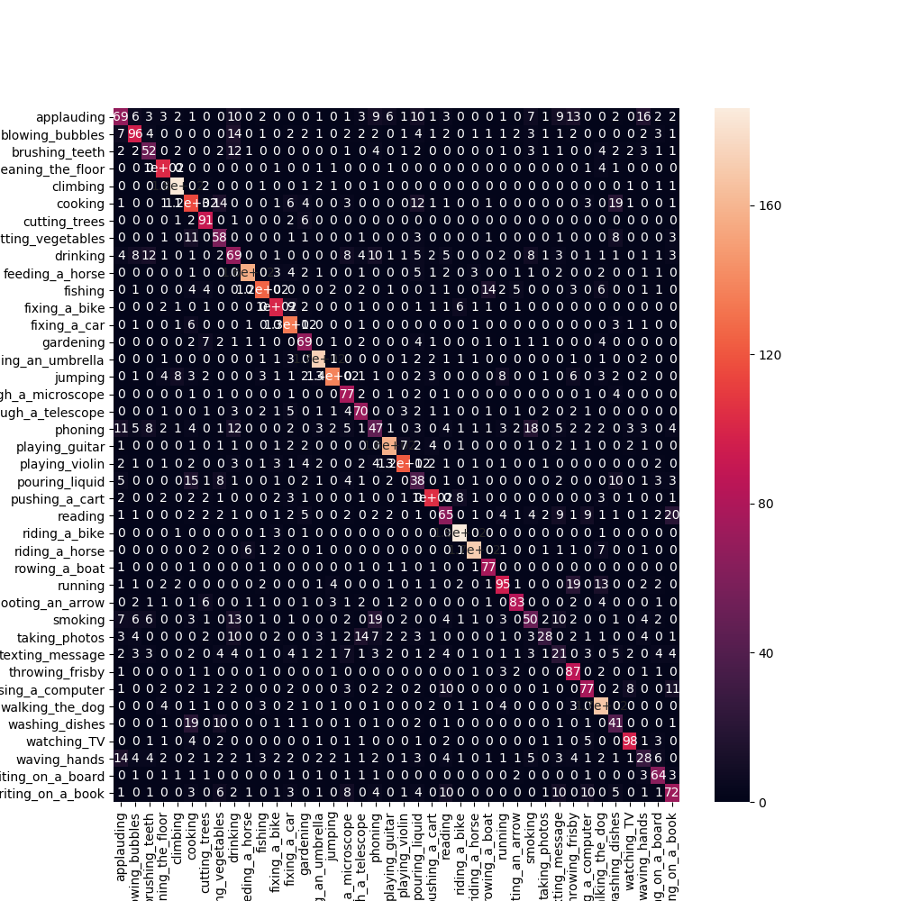
Action Recognition with Automatic Model Search Python/Keras/Tensorflow
This is the project in the course ‘Computer Vision’. We created a Neural Network architecture capable of classifying human actions of the Stanford-40 dataset and optimized it by using methods such as Transfer Learning, weight decay, and custom learning rates.

Slide 11
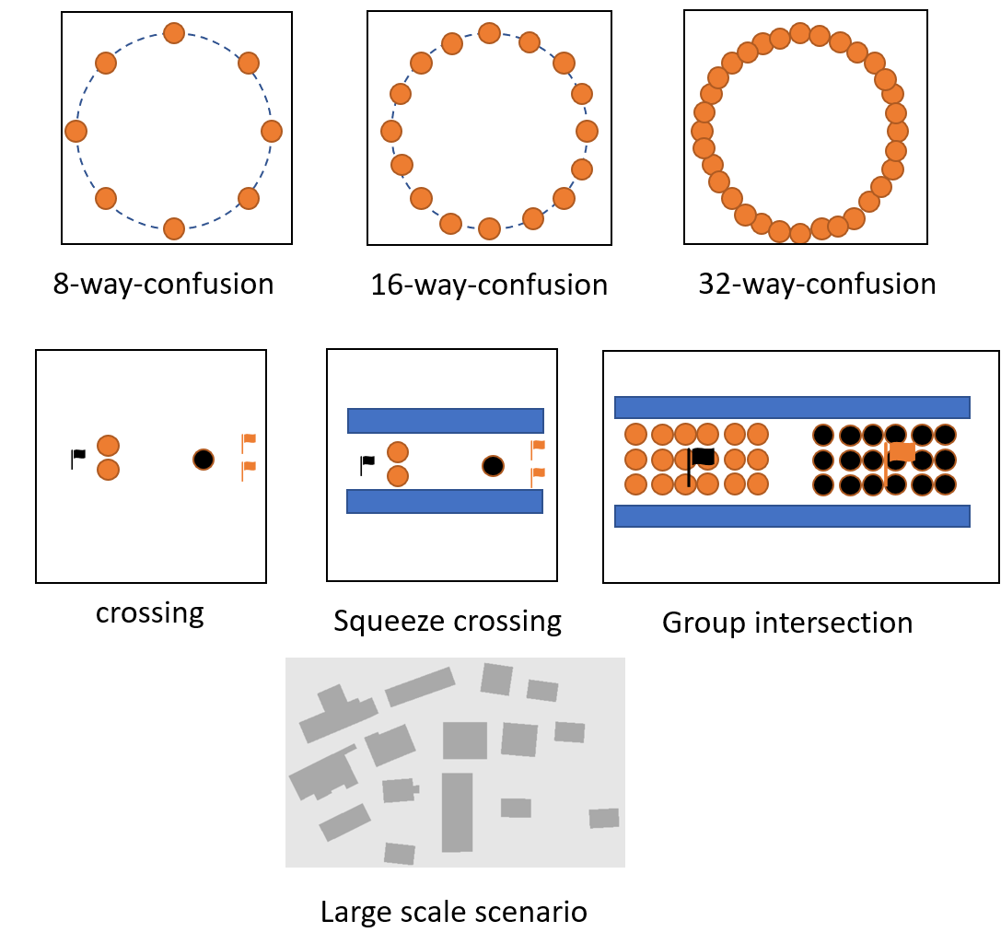
A Comparative Study of Collision Avoidance Algorithms C++
This is the project of the course ‘Crowd Simulation’, we added the implicit crowd algorithm to the UUCS(Utrecht University Crowd Simulation) framework. UUCS is a closed source project. We compared this algorithm with other major algorithms in several test scenes.

Slide 12
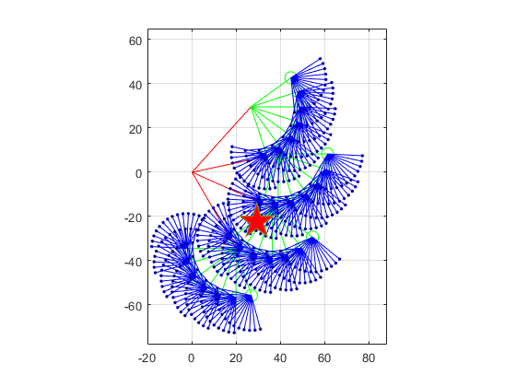
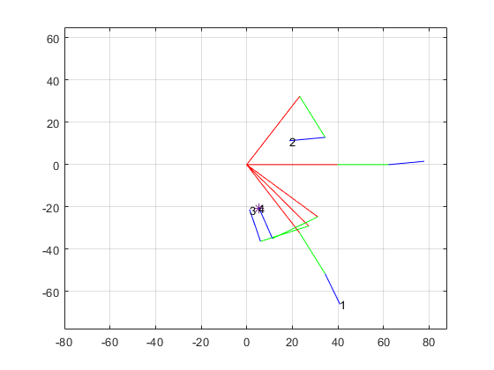
Inverse Kinematics for Human Fingers matlab
This is the project of the course ‘Motion and Manipulation’. First, we simulate the positions one finger (with three joints) can reach. And we use the inverse Kinematics method to compute the angle of each joint iteratively to reach one given position with the constrained joint angles. We provided three solvers:
Pseudo Inverse
Pseudo Inverse with Optimization Derivation
Extended Jacobian Method

Slide 13
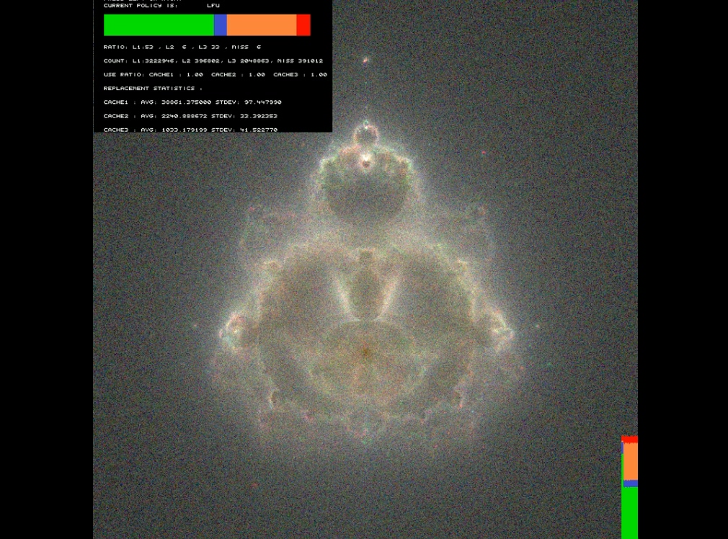
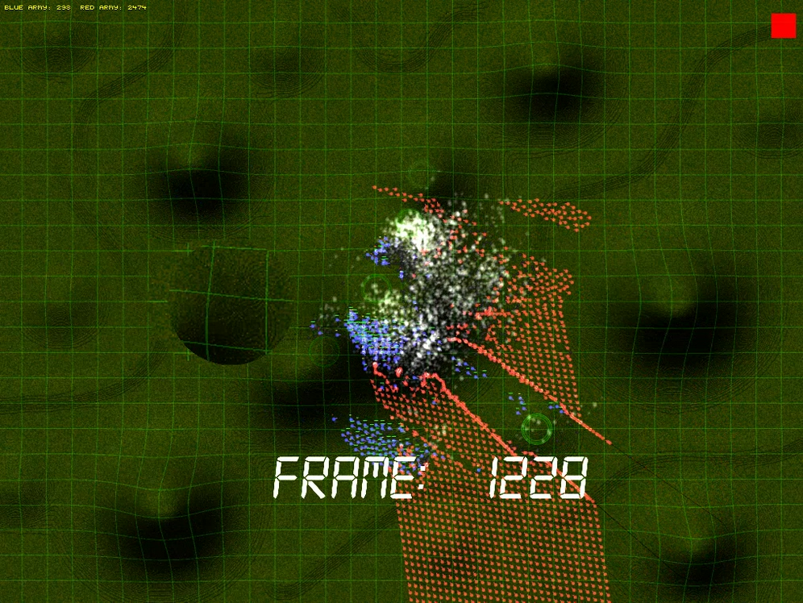
CPU Cache Simulator and Optimization C++
The assignments of the course ‘Optimization and Vectorization’. In the cache simulator, there are three levels cache, and we provide six eviction policies. A tool is provided to monitor the hit ratio. Finally, we can use all the skills we learned to optimize the performance of a small game. I speedup 25 times

Slide 14

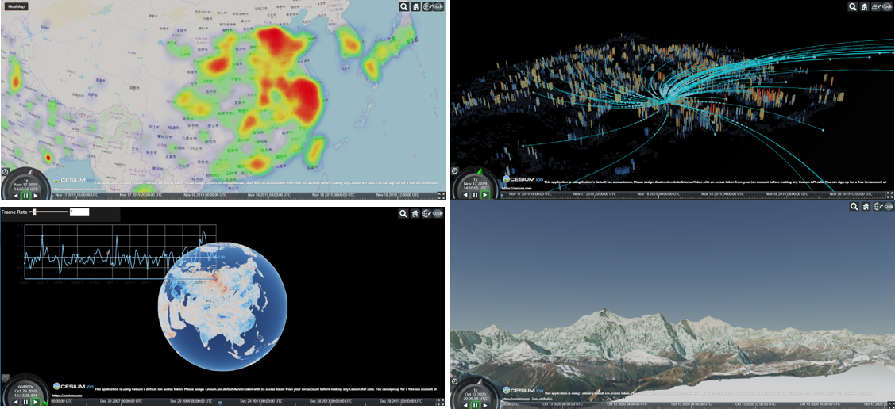
Examples for Cesium JS/WebGL
CesiumJS is an open source JavaScript library for creating world-class 3D globes and maps. I create several visualization demos based on this library, such as real-time global AQI(air quality index), tax flow, ten years of global temperature change, and global terrain.

Slide 15
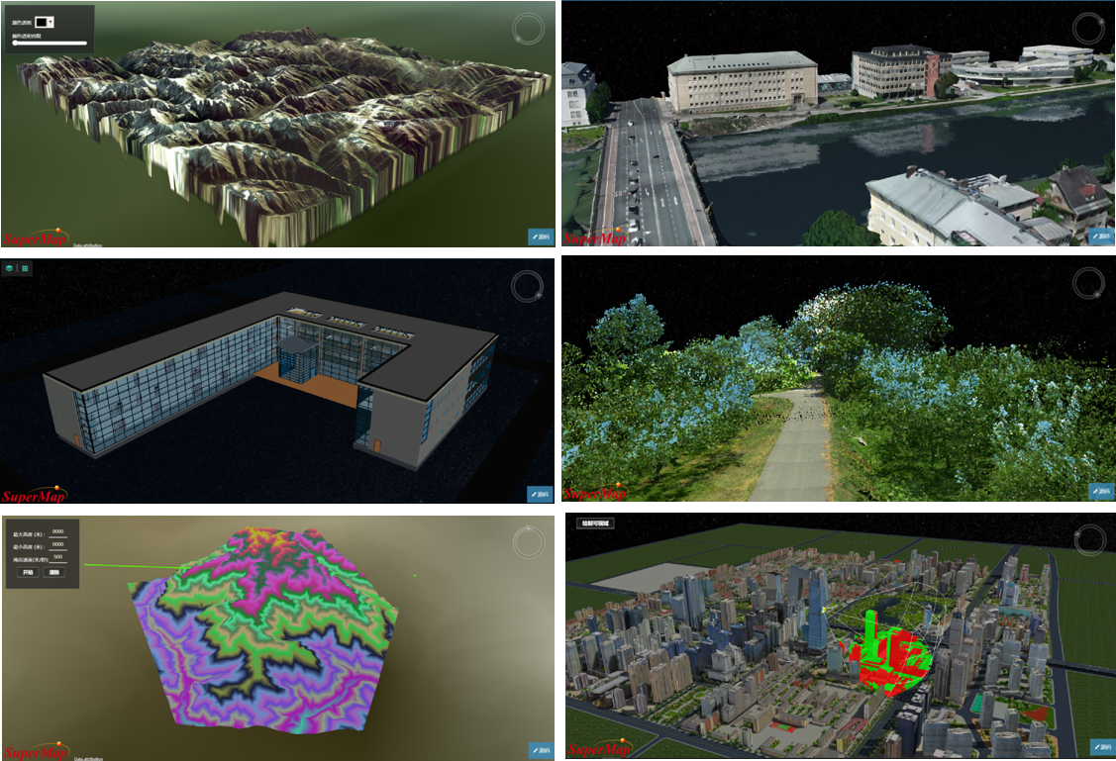
S3M C++/JS/WebGL
S3M is one specification (T/CAGIS 1-2019) in China for the transmission and loading of massive meshes, including oblique photograph, BIM and point cloud. We can do the analysis and visualization on this Spatial geographic data. I was the core engineer to design and develop this format, including the data generation, loading and rendering on the Browser.

Slide 17
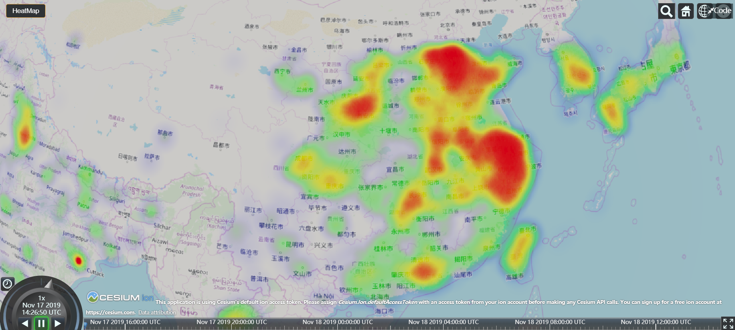
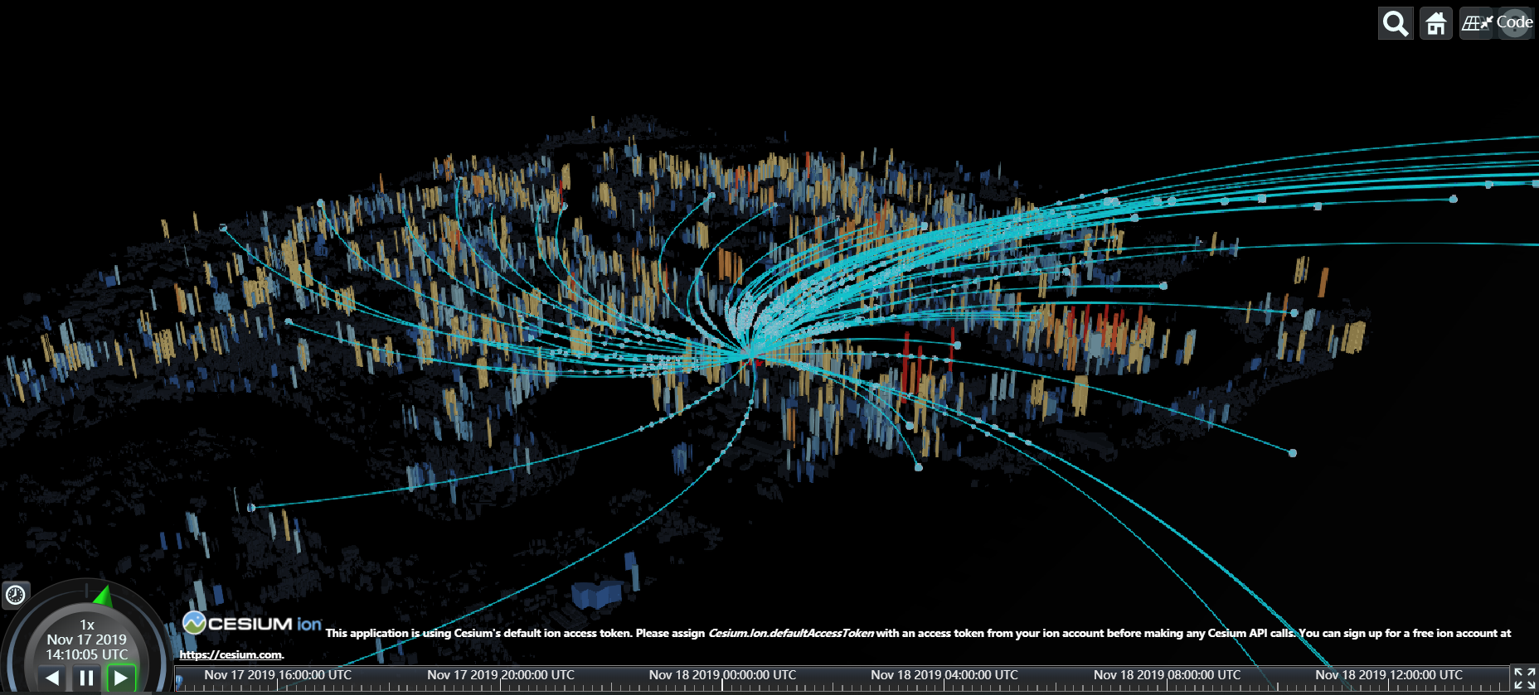
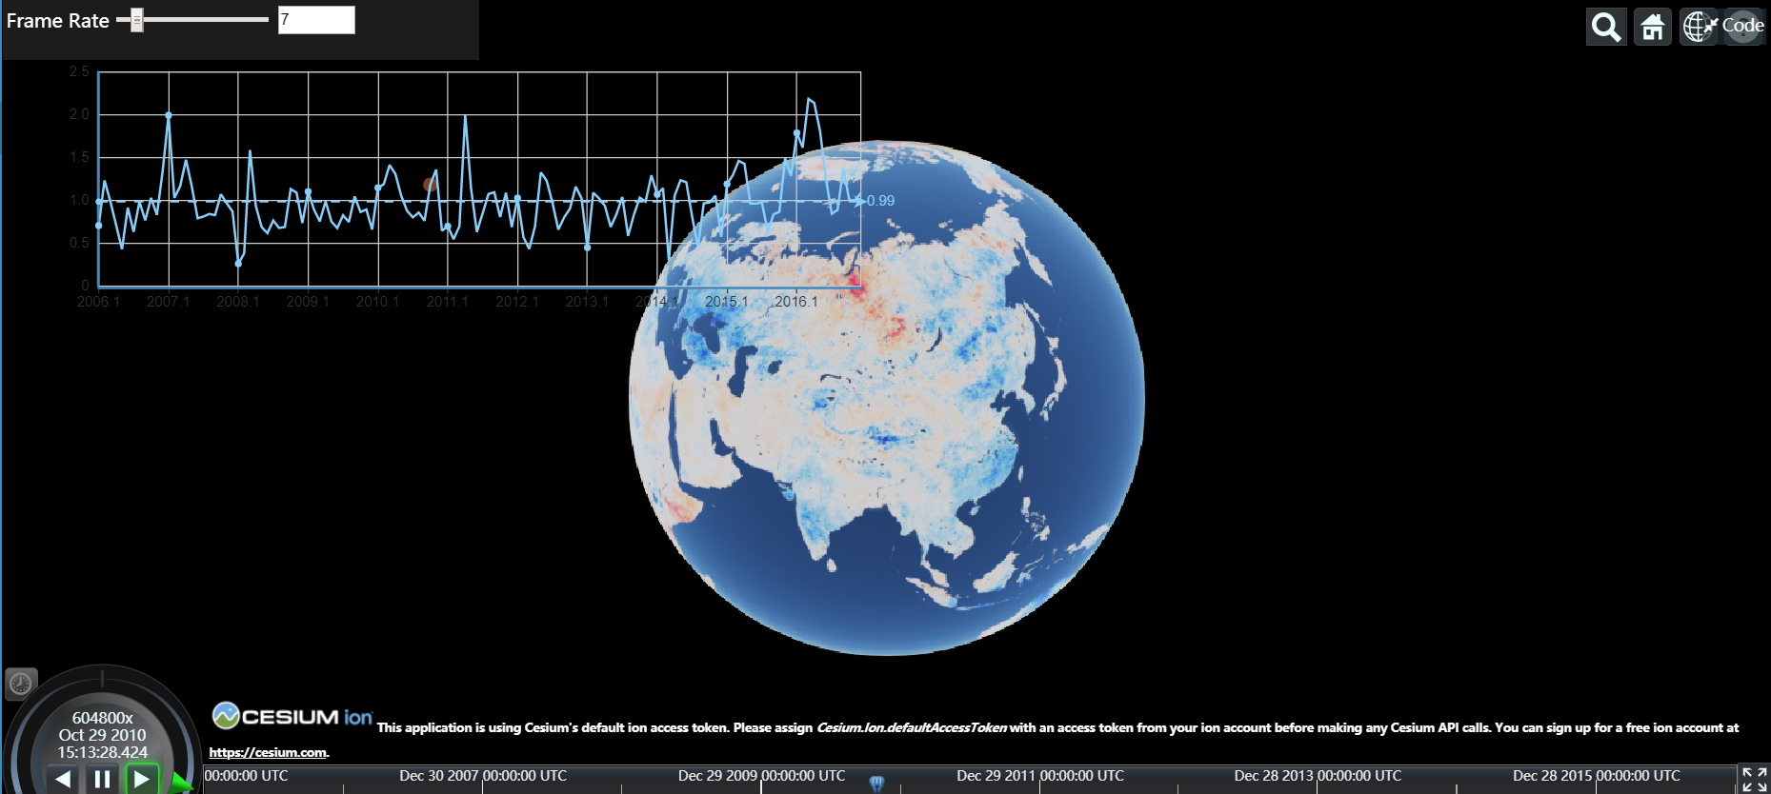
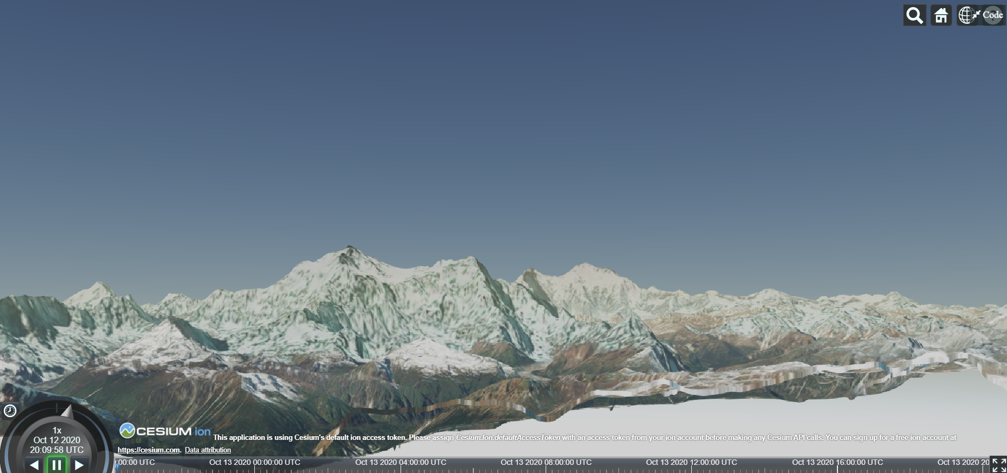

Slide 18
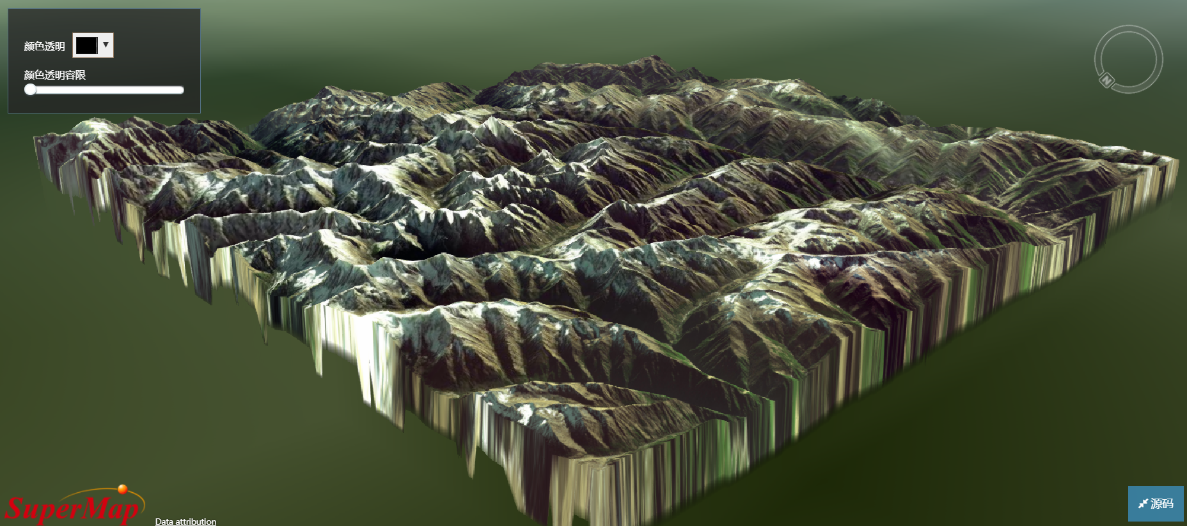
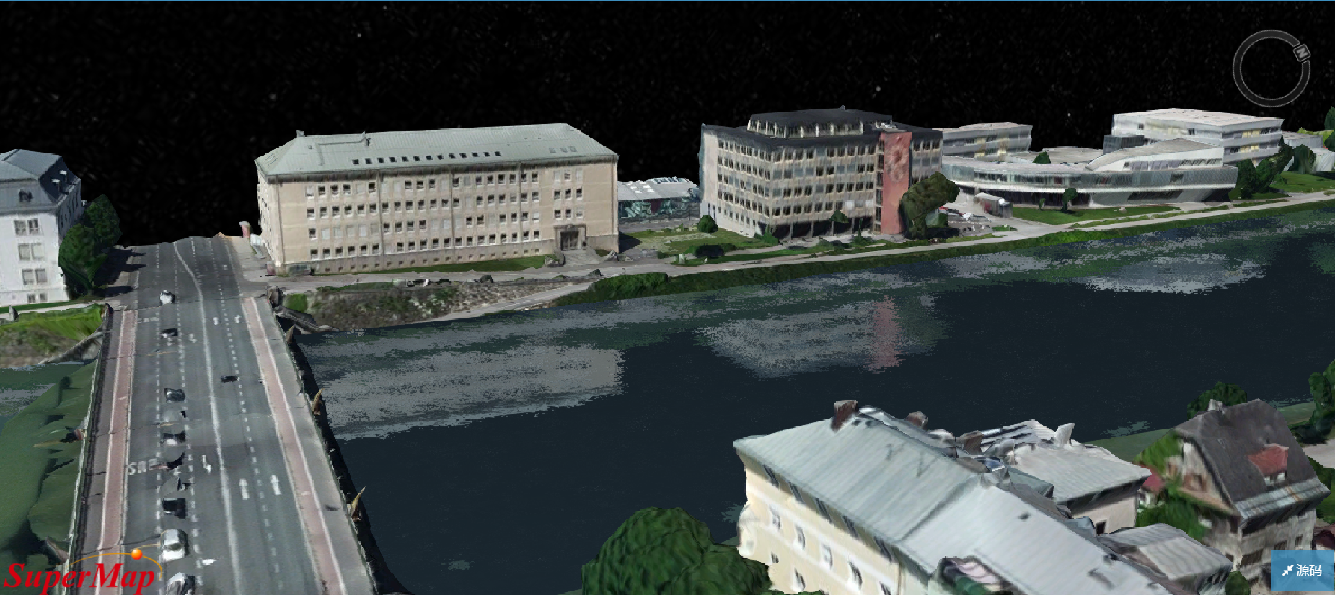
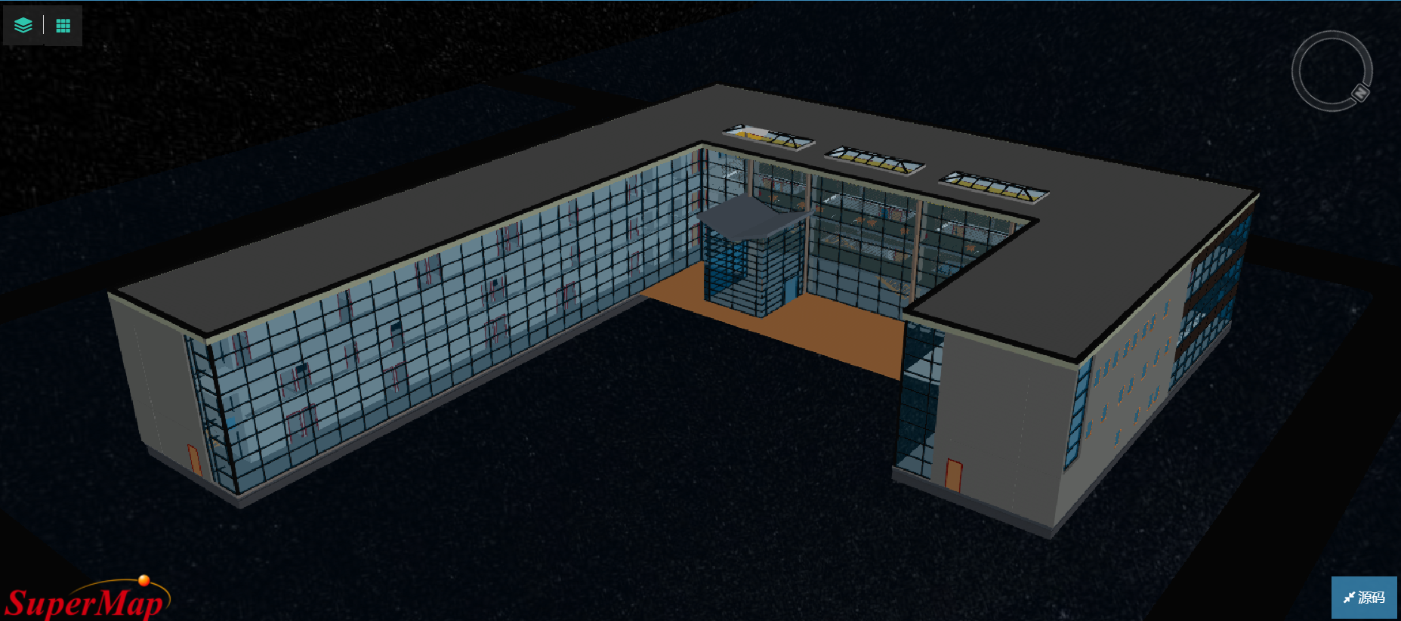
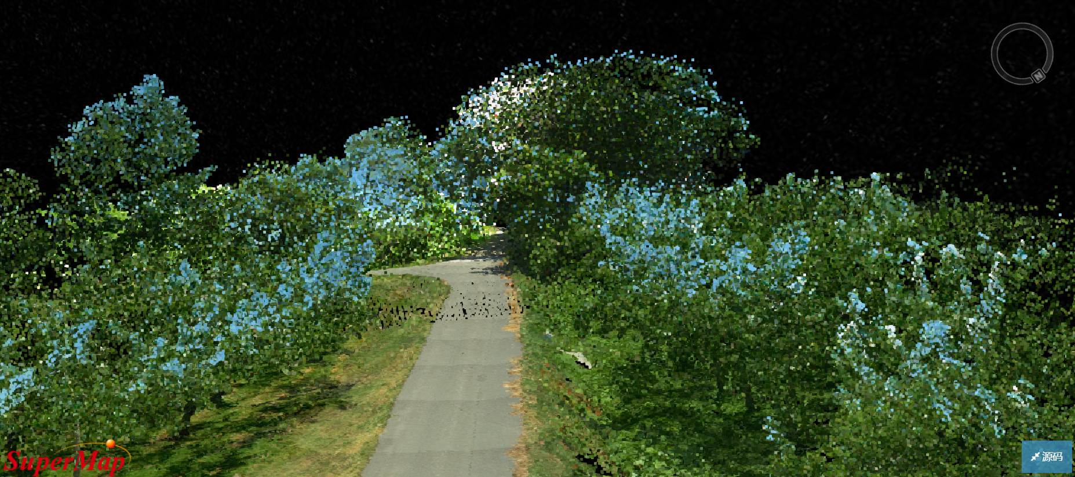
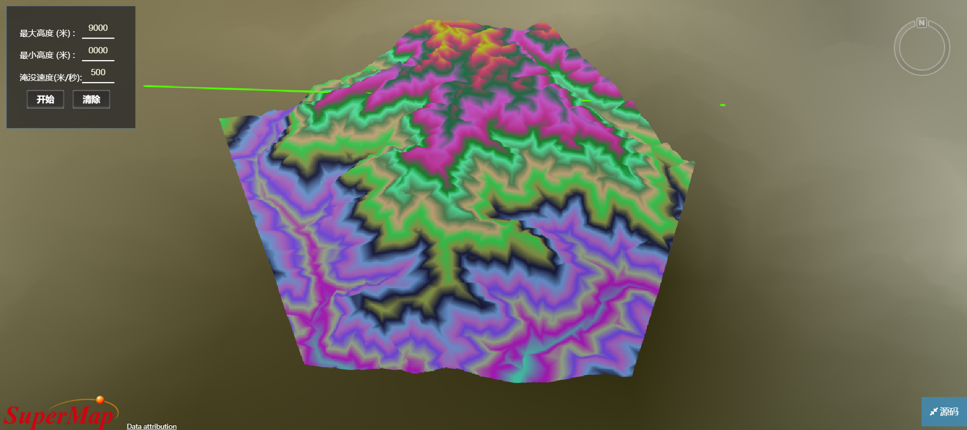
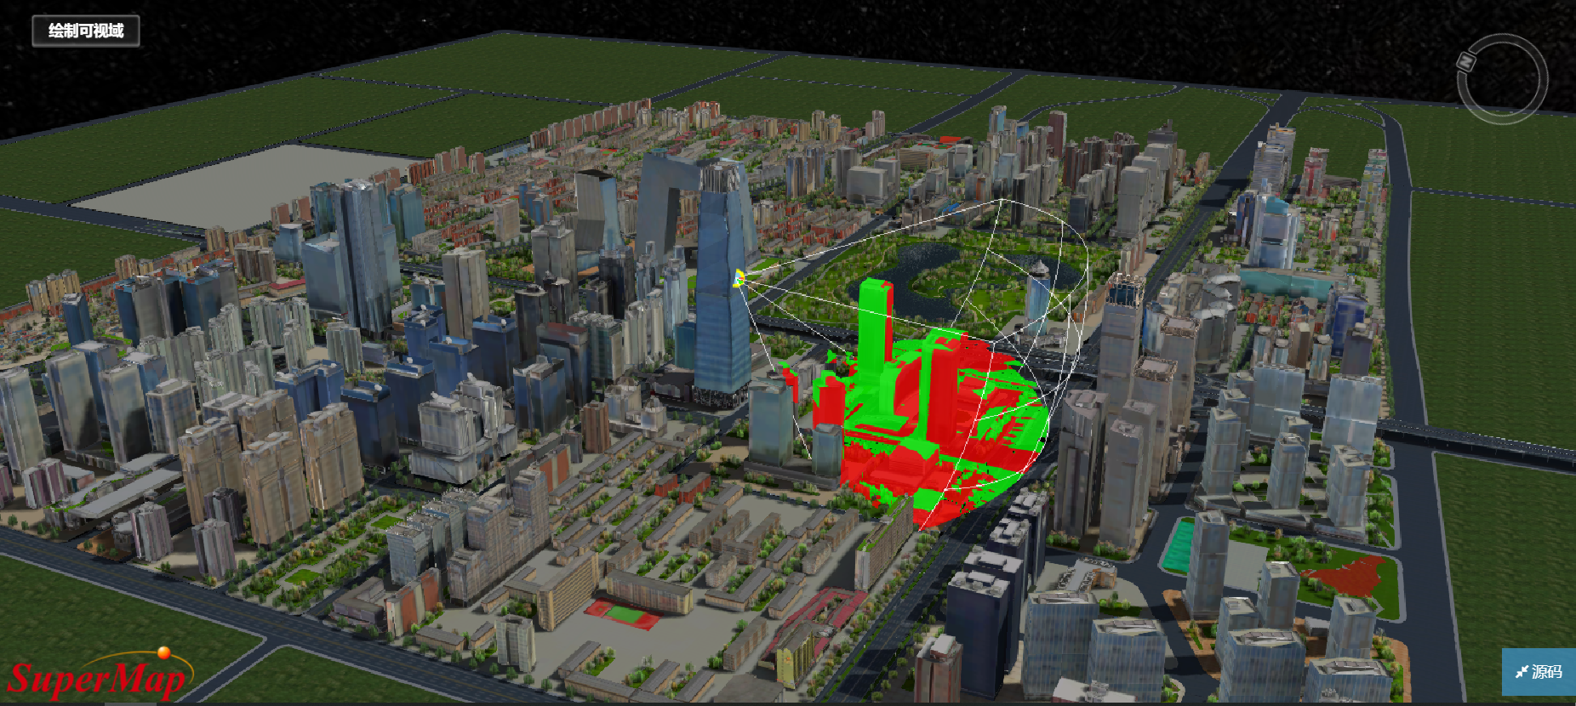

Slide 19
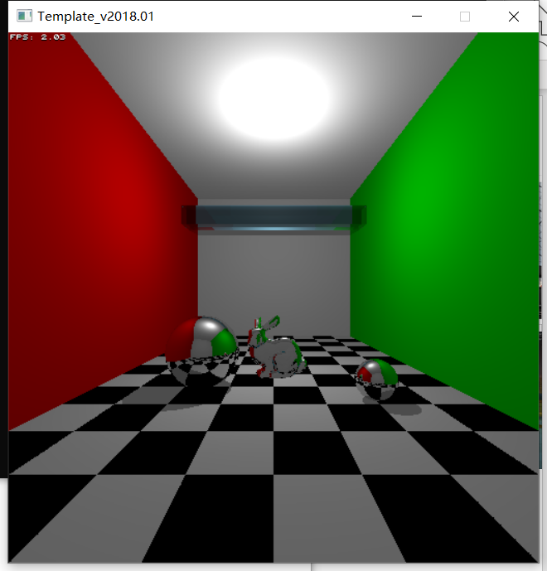
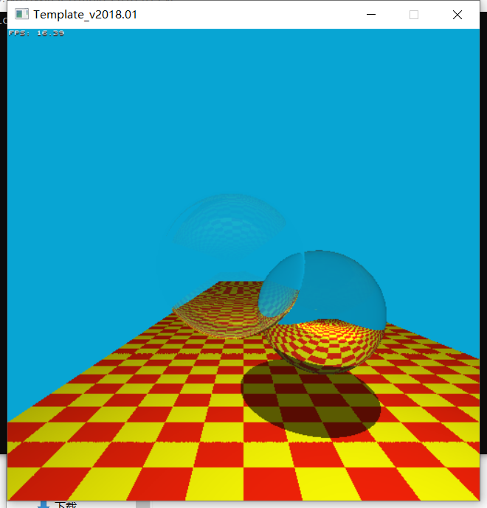
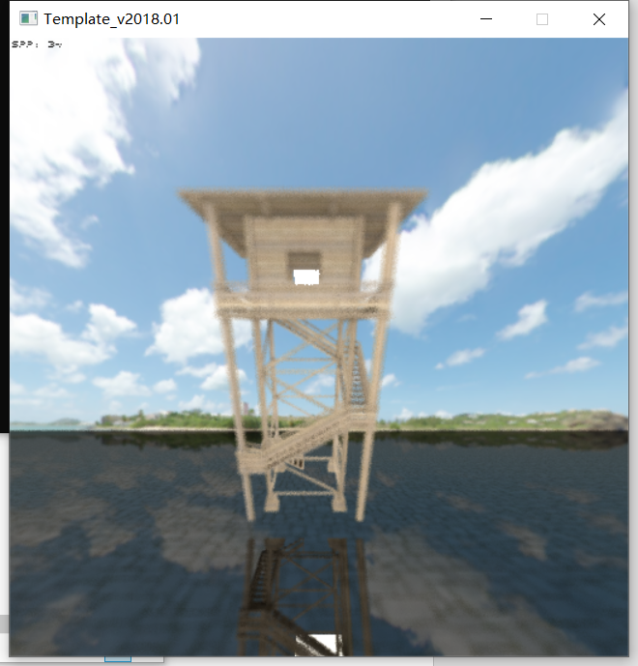
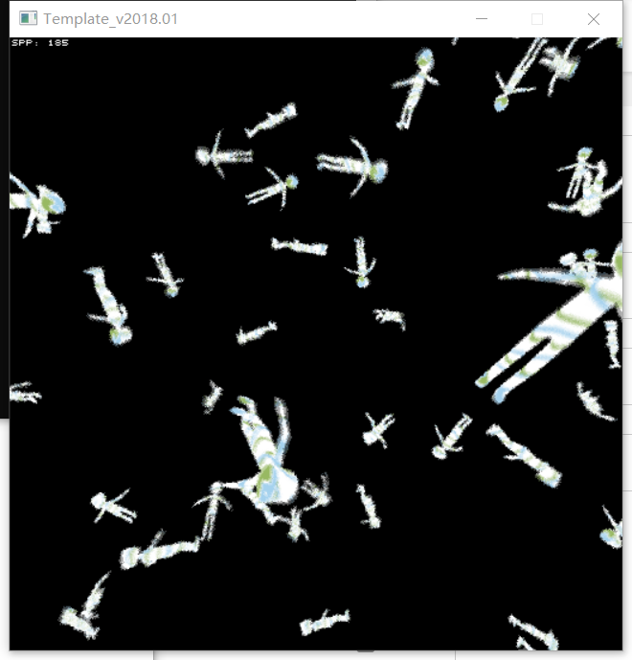

Slide 21
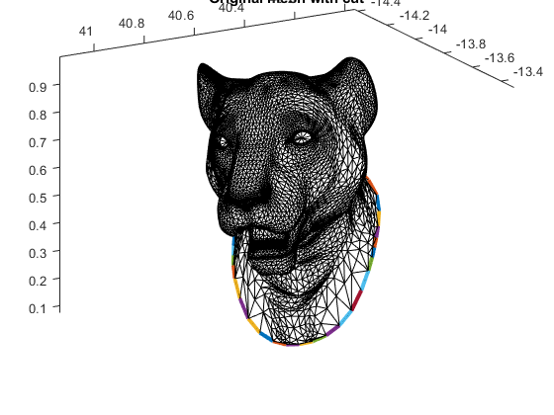
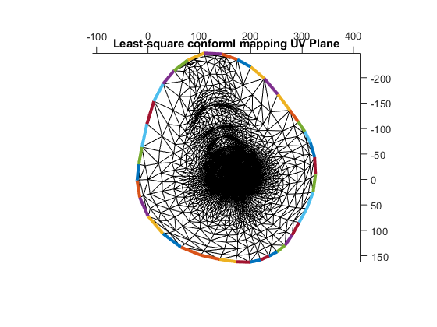
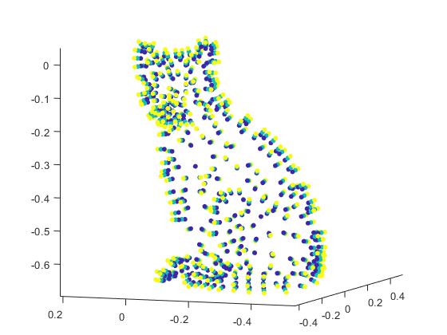
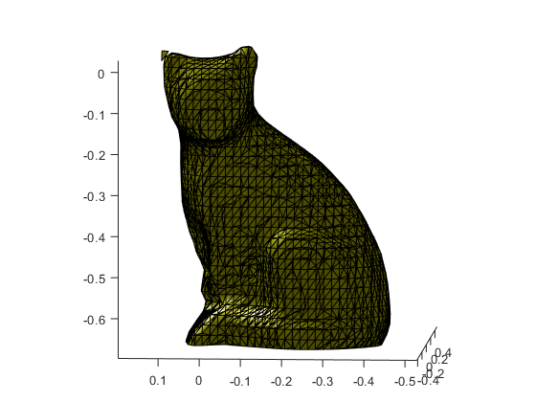

Slide 22
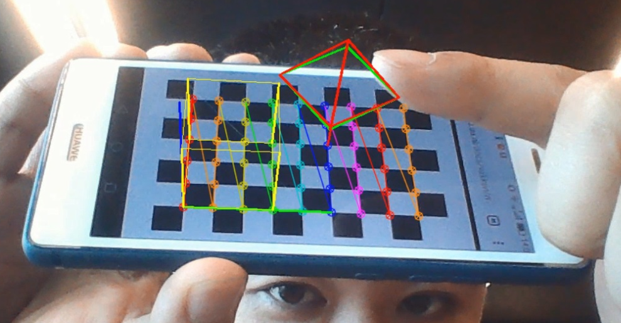
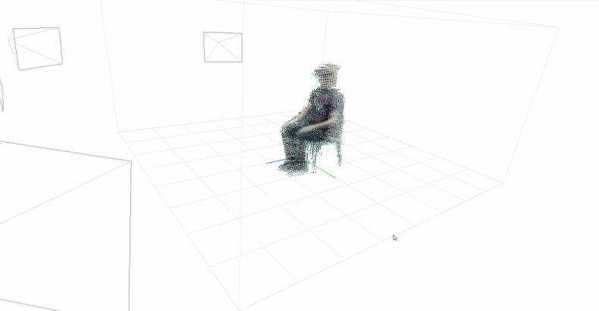
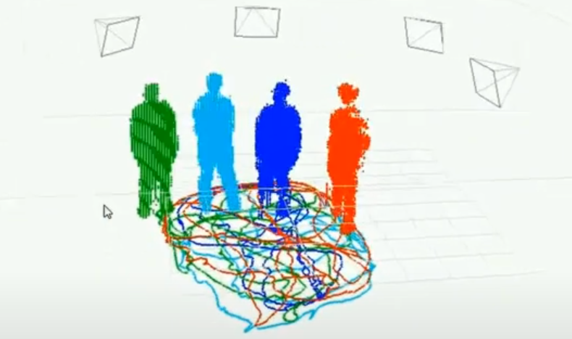
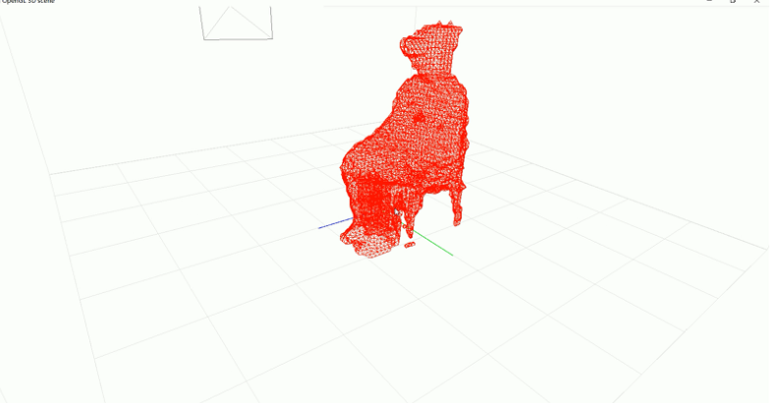
calibration
voxel
wireframe
tracking

